Slide 1
JIRA as a TOOL
For Test MANAGEMENT
Maija Ļaksa, SIA eBIT

Slide 2



Products by Atlassian
Notes:
JIRA is one of the tools developed by Atlassian company (http://www.atlassian.com/).
There are more than 18’000 companies world wide using Atlassian tools.
And these tools are also quite familiar in Latvian IT community.
There are several tools provided by Atlassian. The most popular are:
JIRA – tool for project and issue tracking
Plugins
Greenhopper – tool for agile project management
Bonfire – tool for Exploratory testing
Confluence – a wiki tool for collaboration and content sharing
Several code quality tools – Bamboo, Clover, Crucible, FishEye
Bonfire is dedicated plugin for JIRA to be able to manage testing.
Unfortunately this is commercial plugin and will require additional costs.
What can we do about test management in JIRA and not willing to invest money in other tools?

Slide 3

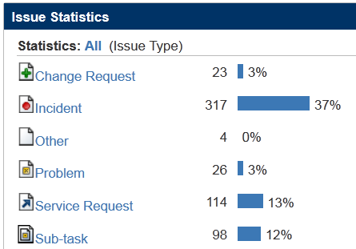
JIRA Concepts of Issue Tracking
Issue types
Notes:
Let’s start with introduction to some basic concepts in JIRA.
Each document or issue in JIRA has an issue type.
Most popular are the ones related to application maintenance – incidents, problems, service requests, change requests
There can be unlimited types of issues defined in JIRA:
- Change Request
- Incident
- Problem
- Service Request
- User Stories
- ...

Slide 4
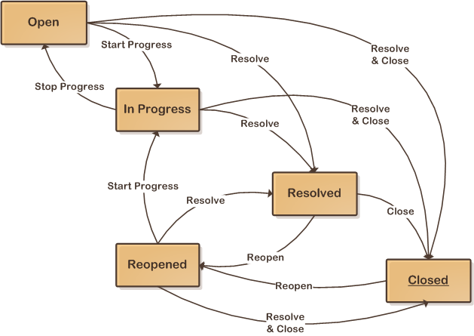
JIRA Workflow Concept
Notes:
Another important concept in JIRA is workflow.
There can be unlimited number of workflows defined.
For each issue type in JIRA project there can be a particular workflow associated.
New workflows can be easily defined.
For each transition between statuses there can be
1) screens containing particular fields configured which can be filled in when transition is executed
2) a performer set - user role provided which can perform a transition
3) post fuctions defined which will be executed – for example – update value of the particul field, perform additional actions
When issue has been created, it has a status – in a sample case – Open.
On the final status it is possible to set resolution for the issue, so that it disappears from the operational views in JIRA.

Slide 5
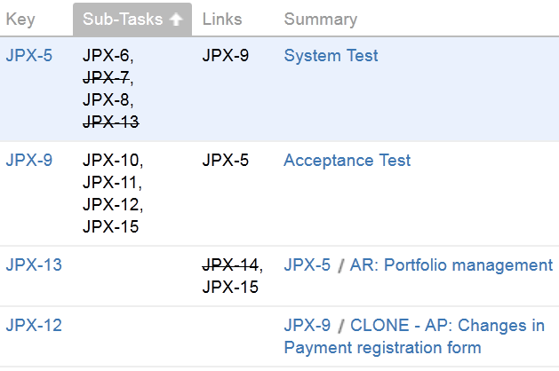
JIRA Issue Relationships
Main issues
Sub-tasks
Links
Notes:
There are two types of relationships available in JIRA by default
When new issue is created it is a Main issue
For Main issue there could be sub-tasks created - if there are several activities to be performed to solve the issue
JIRA default configuration allows only 2 levels in issue hierarchy.
Sometimes it seems to be a kind of limitation, however it is possible to adjust mindset to the limitation and find a solution to be enough with two levels issue hierarchy. Data fields can be used to categorize issues and group relevant ones together.
Links – any two issues can be linked to show relationship between them

Slide 6
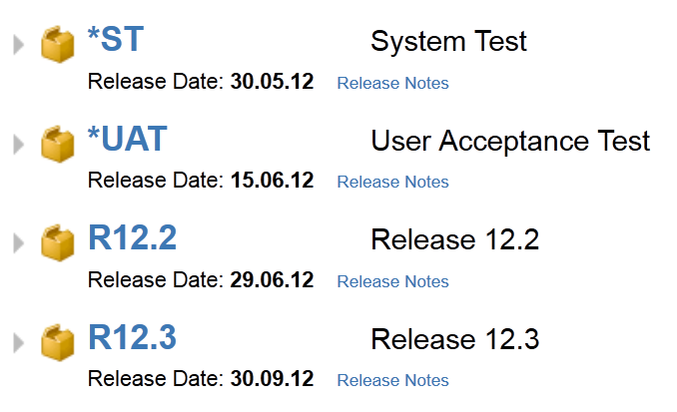
Versions in JIRA
Notes:
Last key concept in JIRA is Versions. Putting issue to the version, JIRA allows to monitor readiness or maturity of the version, called “Road Map”
There can be different use of versions –
in Maintenence projects these could be releases which are defined as versions – e.g
- R12.2
- R12.3
However, these could be also Project phases which are defined as versions – e.g.
- System Test
- User Acceptance Test
There could be also additional version created for Administrative tasks in the project.
--------------------------------------
Now you have beed introduced to basic concepts in JIRA
– issue types
- workflows
- relationships between issues
- versions
Now I’m going to discuss how the same concepts can be used also for testing management not only issue and project tracking.

Slide 7
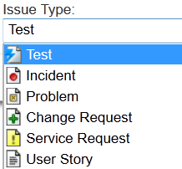
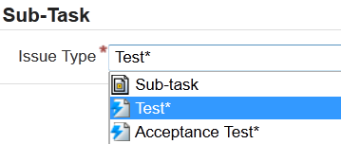
Issue Types for Test Management
Notes:
As the first step to configure JIRA to support Test management is to define new issue types.
On the main level we defined one issue type – Test
On Sub-task level we defined Test* and Acceptance Test*
We put * at the end of issue type because issue type name should be unique in JIRA. But still we wanted to have issue type names similar to be easier used in searches afterwards.

Slide 8
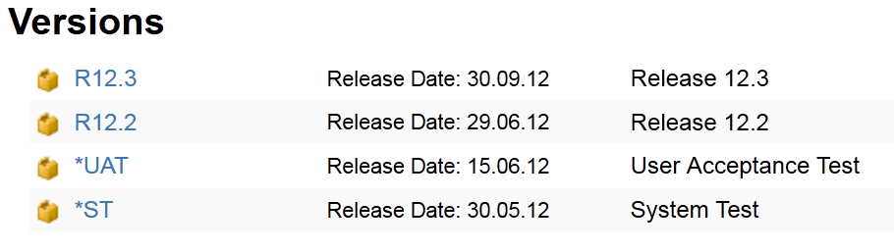
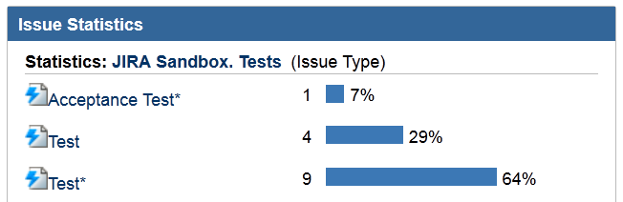
Testing Phases
Notes:
To maintain Testing Phases we used two approaches:
Define Versions to correspond to Testing Phases:
System Test
User Acceptance Test
OR
Use different issue types for Tests performed by
Supplier team (Test*)
Customer team (Acceptance Test*)

Slide 9
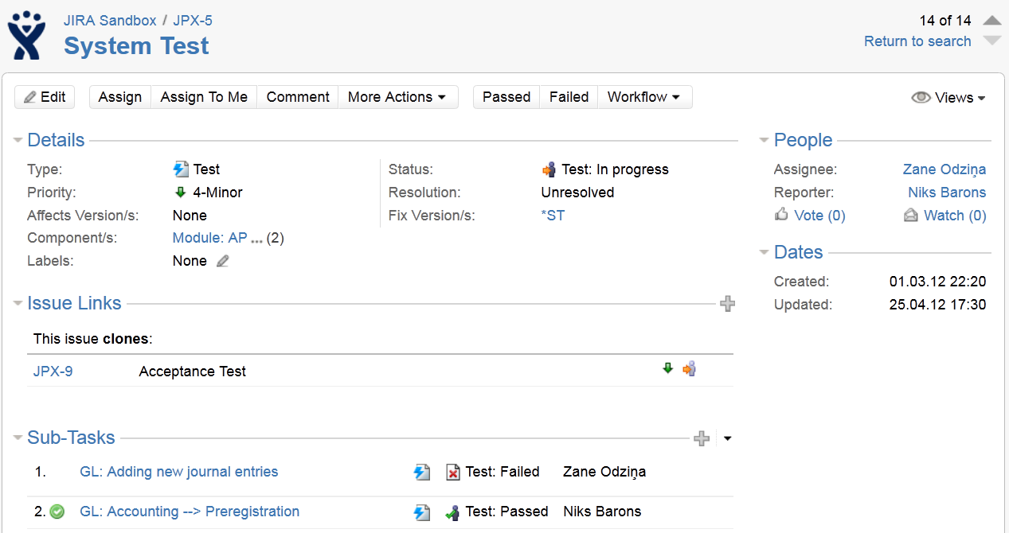
JIRA Issue View
Notes:
Let’s check key elements on JIRA issue:
Issue Type – Test
Fix Versions
Linked issues
Sub-tasks

Slide 10
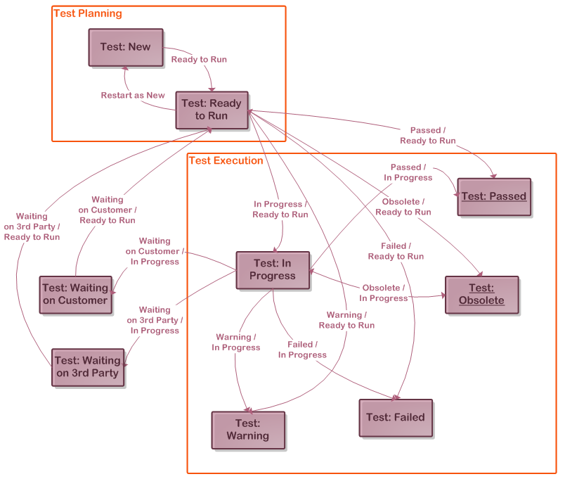
Testing Workflow
Notes:
To support test management we have defined a new workflow. We used the same workflow for all issue types related to testing.
To define Issue statuses for test management we prefixed all test related statuses with “Test:”
This helped to sort test related statuses together in JIRA reports and views.
The first 2 statuses can be used while in Test planning phase – to start to create tests and sub tasks as early as possible in the project, which will be part of test plan – to document all tests which will need to be executed.
At planning phase all issues can be assigned to test manager, and then, when decided who will test what – tests can be re-assigned to the actual tester and issue can be moved in wirkflow to the step “Test: Ready to Run”
Or test can be assigned to dedicated tester if there will be needed to provide detailed information about what test activities will be performed.
The following statuses are related to Test Execution:
- In Progress, ....
There are 2 final statuses in Test workflow where resolution will be set:
- Test: Passed – Resolution = ‘Fixed’
- Test: Obsolete – Resolution = ‘Won’t fix’

Slide 11
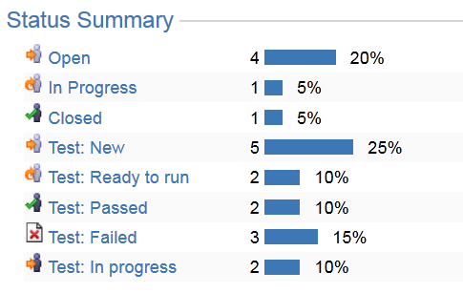
Test Statuses
Notes:
This is how test related statuses look like on JIRA online reporting gadgets.

Slide 12
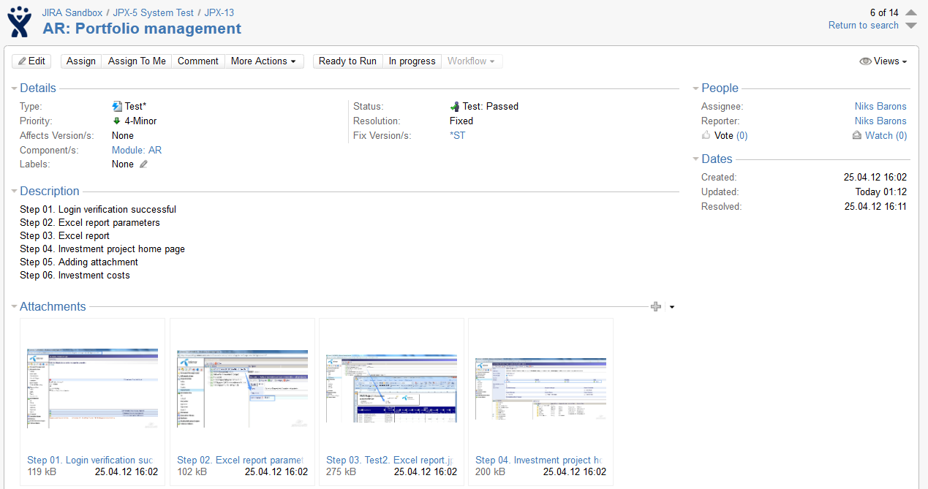
Notes:
Let’s check key elements on JIRA issue:
Issue Type – Test
Master issue number / sub-task issue number
Issue Status / Resolution / Fixed versions
Workflow actions
Description == test steps, test procedure – free formatting
Test results as screenshots

Slide 13
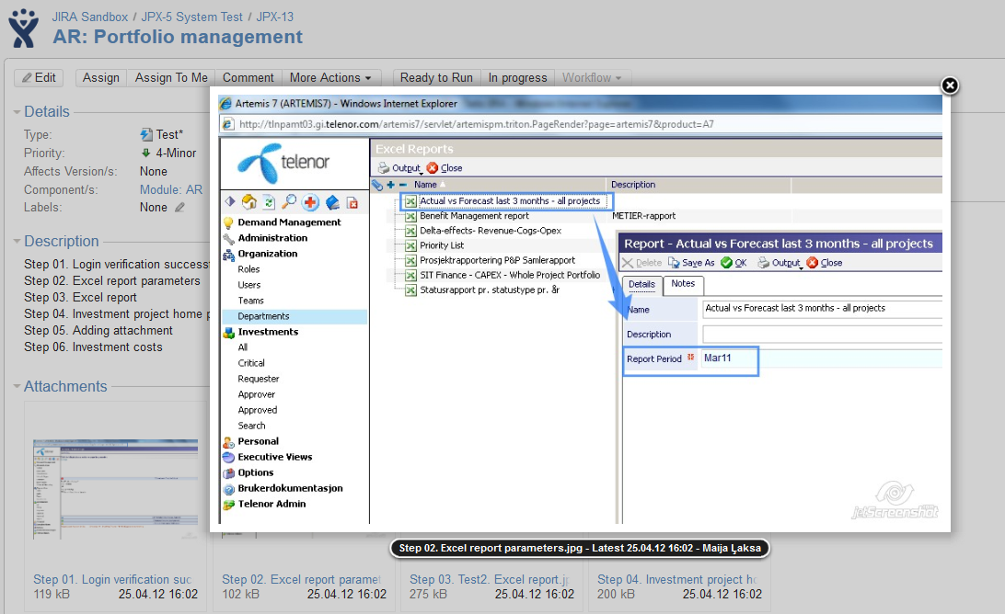
Notes:
Attached screenshots can be easily reviewed.

Slide 14
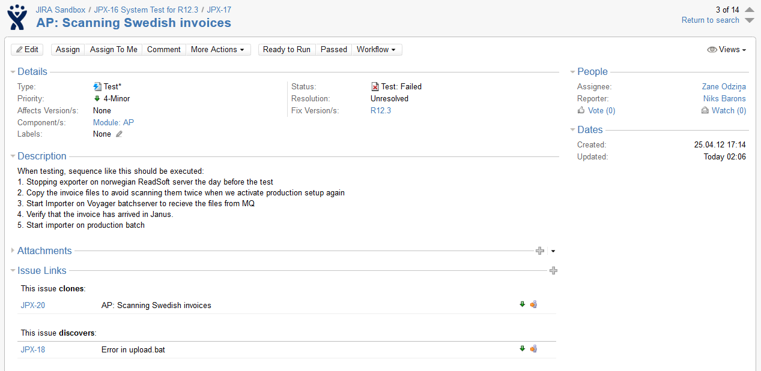
Test Execution
Notes:
Let’s check key elements on JIRA issue:
Issue status
Workflow actions
Links to related issues

Slide 15
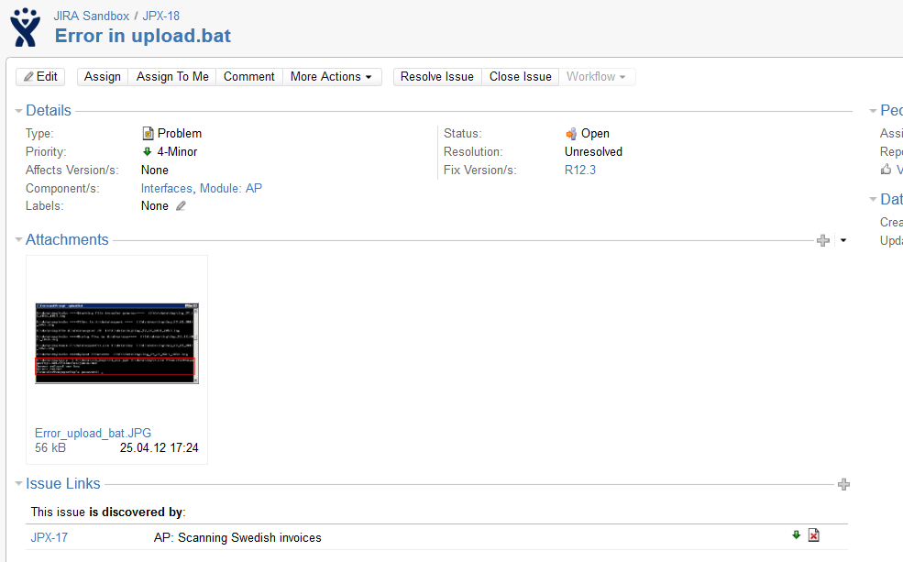
Test Failure → Problem Report
Notes:
Let’s check key elements on JIRA issue – discovered failure during test execution:
Links to related issues

Slide 16
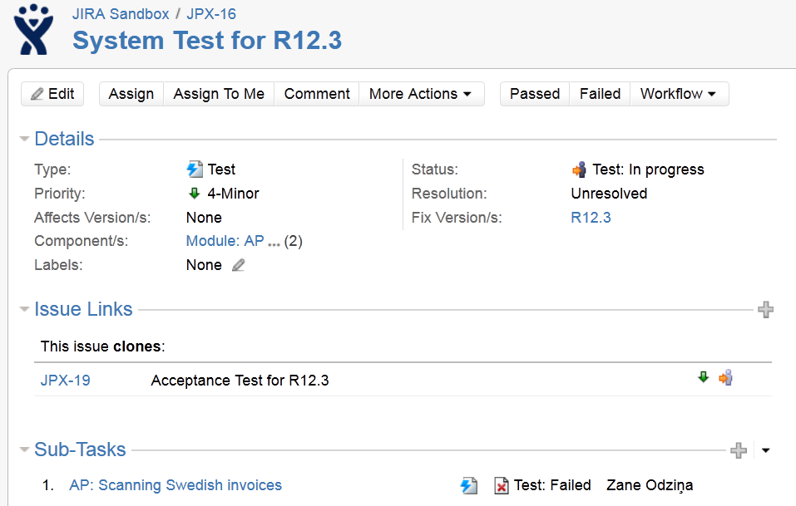
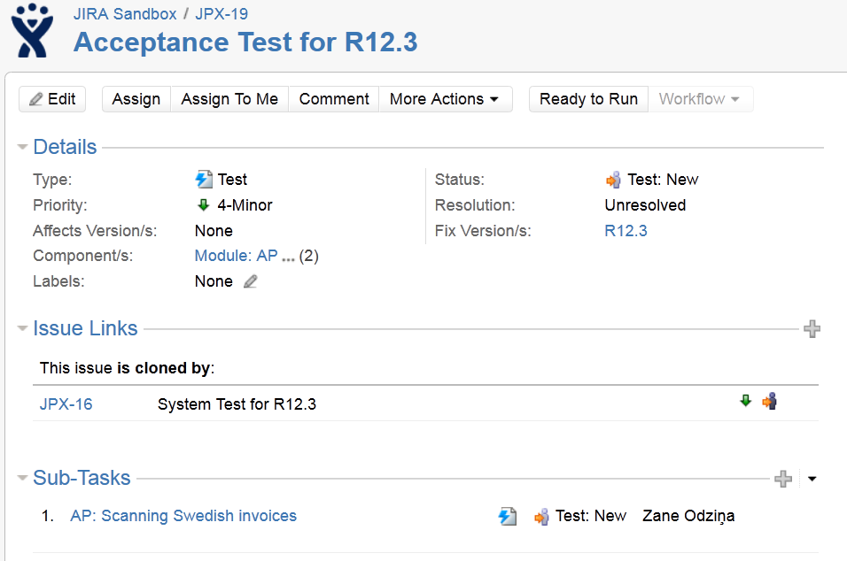
System Test → Acceptance Test
Clone
OR
Clone and Move
Notes:
There is Clone and Move functionality in JIRA which allows to create copy from System Test to Acceptance test

Slide 17
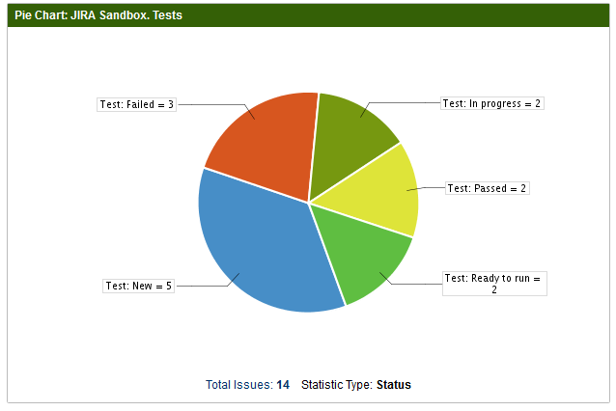
Test Management –
Status Report
Notes:
Sample online reports available in JIRA – pie charts

Slide 18
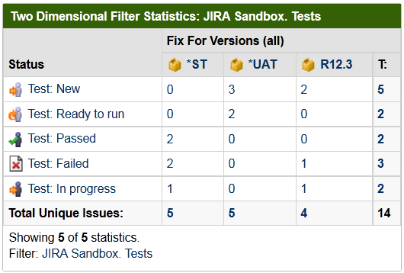
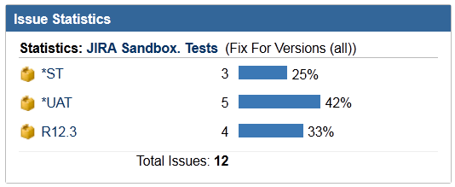
Test Management –
Status Report
Notes:
Sample online reports available in JIRA
– two dimensional filter statistics
- Issue statistics

Slide 19
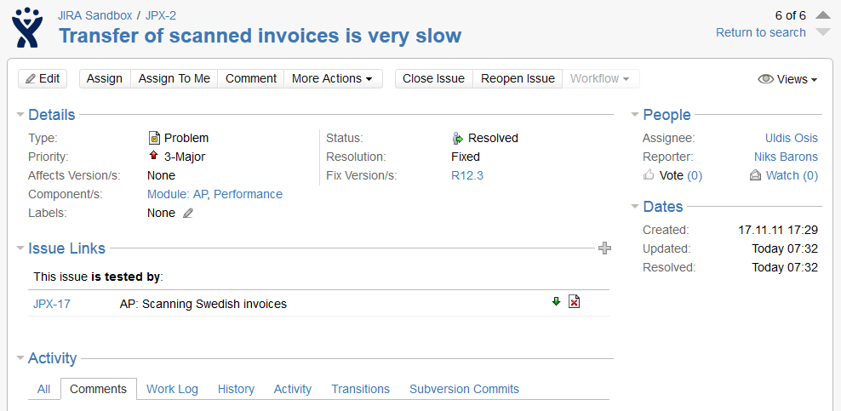

Testing in Maintenance
Notes:
Samples demonstrated so far were suitable for development or implementation projects where testing is a separate project phase and testing tasks are planned independently from reported issues.
In application maintenance projects testing is closely related to reported issues.
In such cases testing activities can be created as sub tasks to the reported incident or problem, or link between problem and test can be created: Problem .. is tested by ← → Test .. is testing

Slide 20
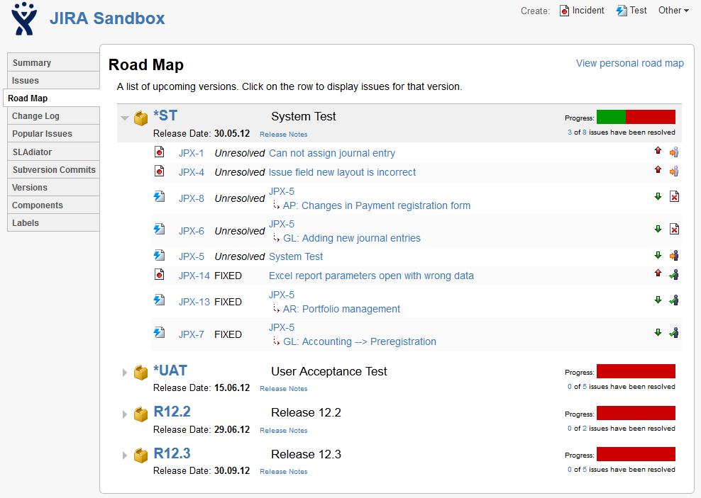
Version Maturity
Notes:
JIRA allows to monitor maturity of the version – Road map
It shows number of Fixed issues linked to the version and issues still in progress

Slide 21
JIRA Demo
Try JIRA on your own!
JIRA OnDemand
www.atlassian.com/software/jira/try/
Notes:
!!!!DEMO!!!!
https://jira.ebit.lv/secure/Dashboard.jspa
zane.odzina@ebit
- Dashboards
-- Test
-- All
- Project roadmap
- Project summary

Slide 22

Questions?
Maija Ļaksa
maija.laksa@ebit.lv
www.ebit.lv

